Slide 1
新人週報
撰寫人:s220 魏子鈞

Slide 2
報告主題
6200 傳送
GSD-200 傳送
E500 傳送

Slide 3
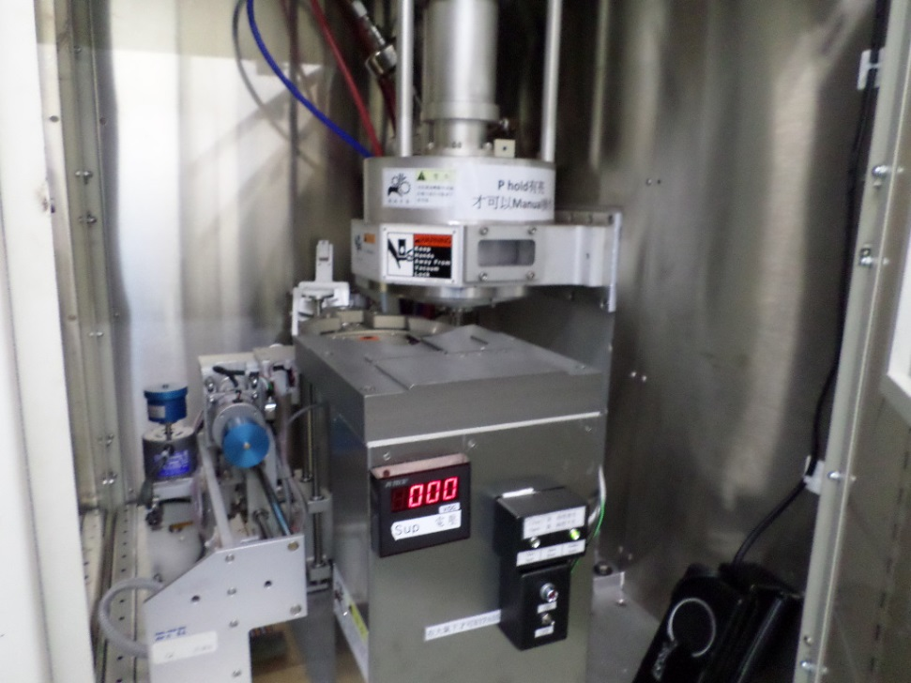
6200
Input Cassette
Input Shuttle
Input Transport Arm
Flat(Orient)
Input Load lock
Input Bell

Slide 4
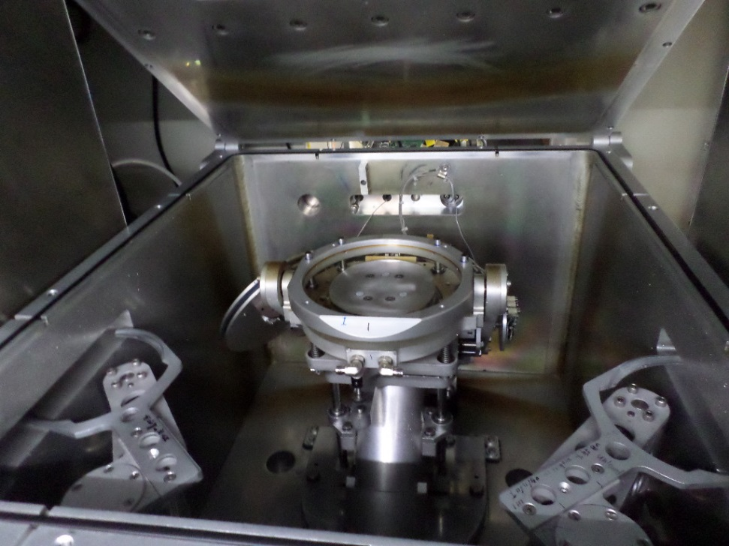
6200
Load Arm
Chuck
Unload Arm

Slide 5
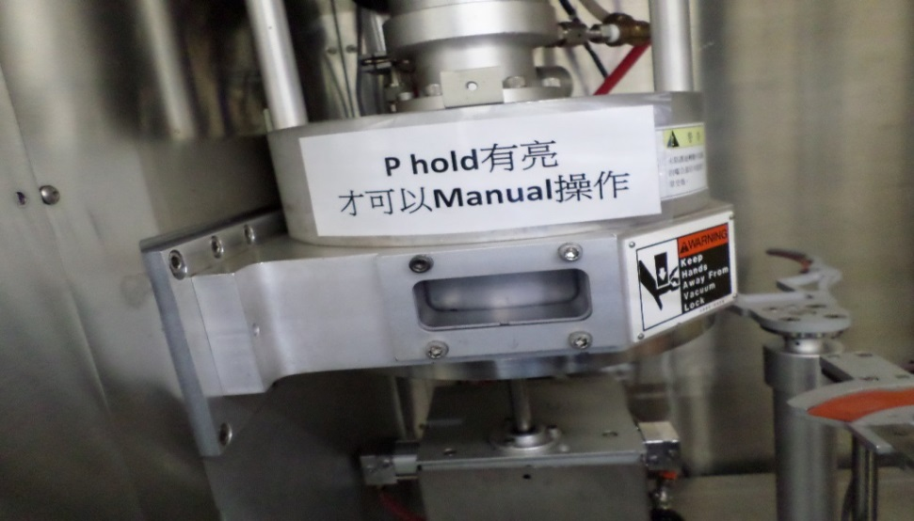
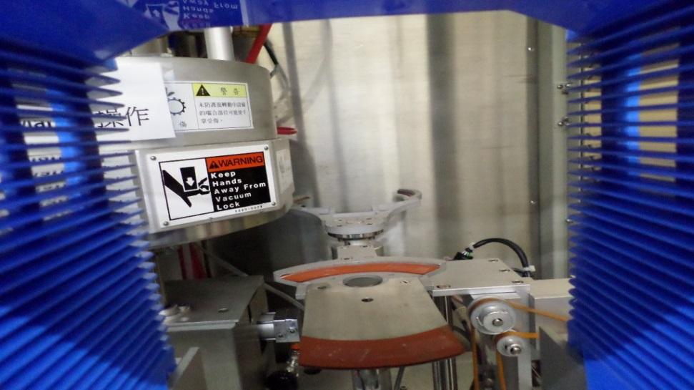
6200
Output Cassette
Output Shuttle
Output Transport Arm
Output Load lock
Output Bell

Slide 6
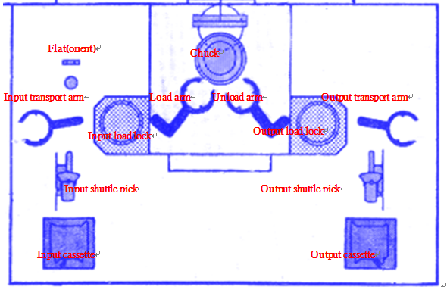
6200
6200傳送俯視圖
Input Cassette→Input Shuttle→Input Transport→Flat→Input Load lock→ Load arm→Chuck
Chuck 1/2
Chuck→Unload Arm→Output Load lock→Output Transport→Output Shuttle→Output Cassette

Slide 7
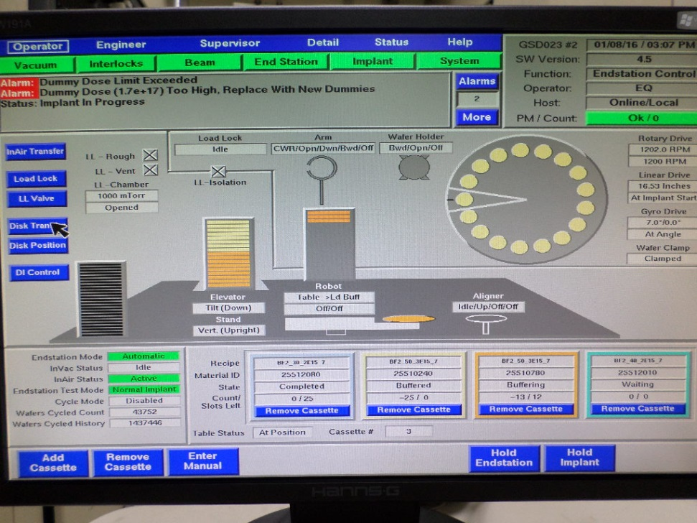
GSD-200/ In-Air Handling
Robot
Flat aligner
Load buffer
Dummy Buffer
Table

Slide 8
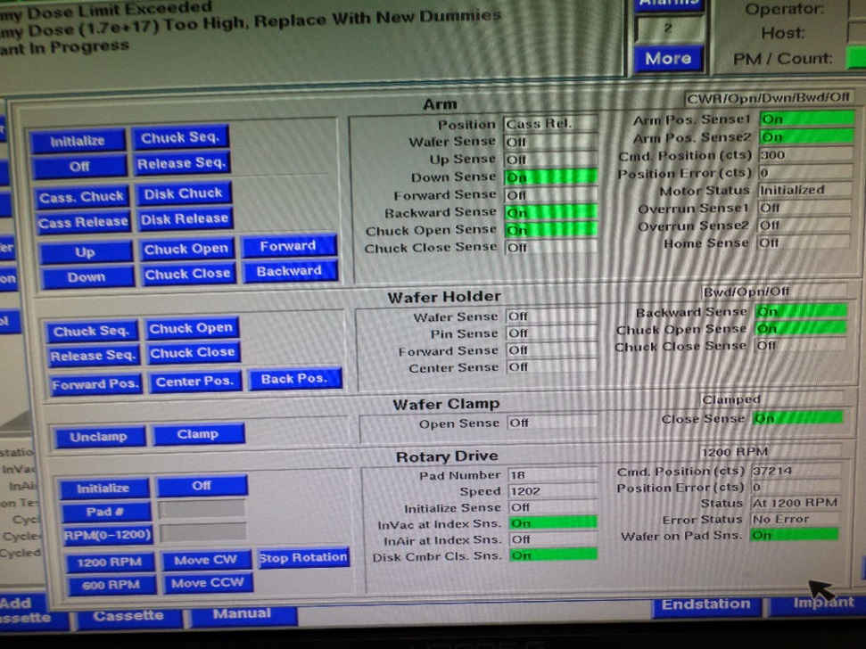
GSD-200/ In-Vacuum Handling
Arm
Wafer Holder
Wafer Clamp
Rotary Drive

Slide 9
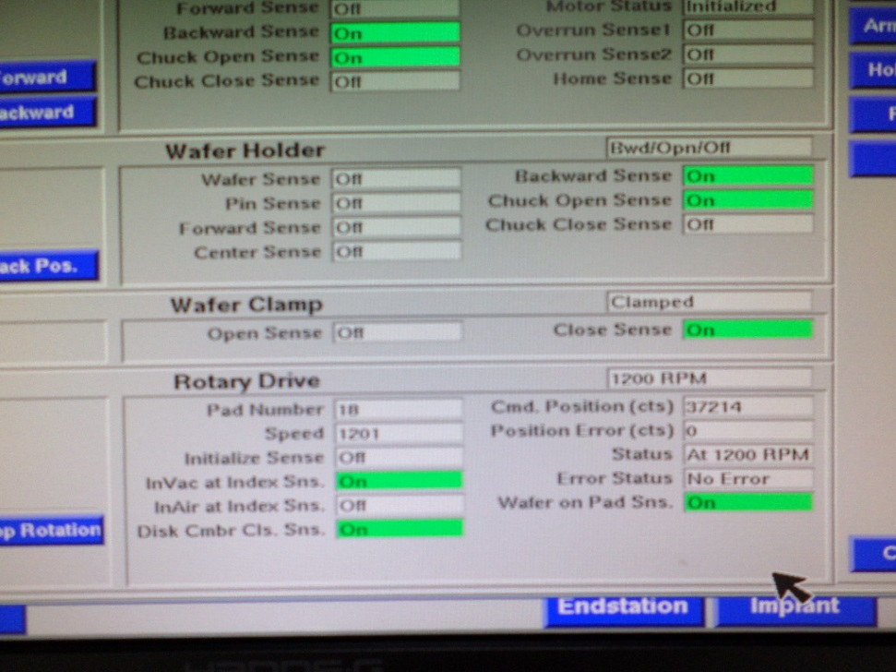
GSD-200/ Disk Drive and Position
Rotary drive
Y-scan
Gyro control

Slide 10
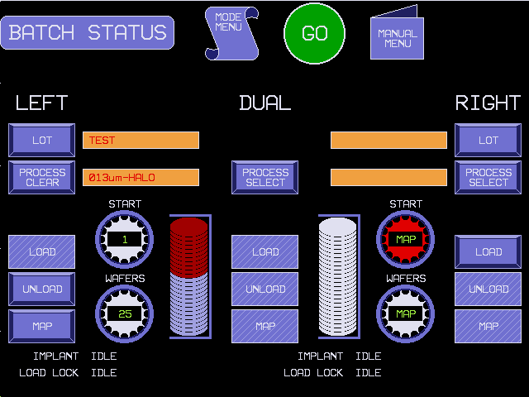
E500/上貨介面
Load/Unload
Map

Slide 11
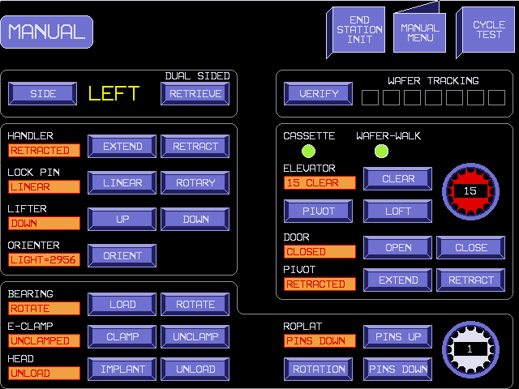
E500/單手臂
Handler (Extend/Retract)
Lock Pin (Linear/Rotary)
Lifter (Up/Down)
Orienter (Orient)
Bearing (Load/Rotate)
E-clamp (Clamp/Unclamp)
Head (Implant/Unload)
Roplat (Pinsup/PinsDown/Rotation)
Elevator (Clear/Loft/Pivot)
Door (Open/Close)
Pivot (Extend/Retract)

Slide 12
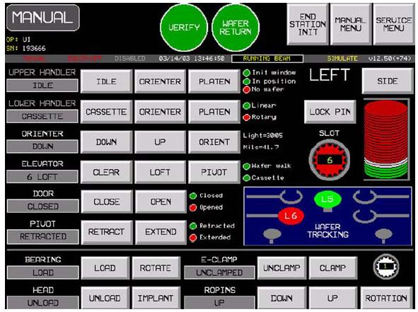
E500/雙手臂
Upper handler (Idle/Orienter/Platen)
Lower handler (Cassette/Orienter/Platen)
Orienter→(Orienter/Lifter)
Lock Pin

